Slide 1
Strategic Forecasting of Customer Lifetime Value: Enhancing Business Insights Through Predictive Analytics

Slide 2
CONTENTS
ABSTRACT
INTRODUCTION
LITERATURE SURVEY
EXISTING & PROPOSED SYSTEM
SOFTWARE REQUIREMENTS
RESULTS
CONCLUSION
REFERENCES

Slide 3
ABSTRACT
  This study focuses on modelling Customer Lifetime Value (CLV) to assist businesses in optimizing customer relationship management (CRM). By leveraging the BG/NBD and Gamma-Gamma probabilistic models, the expected number of transactions, customer retention probabilities, and monetary value per transaction are calculated. Data preprocessing involves cleansing and aggregating key features such as recency, frequency, and monetary value. Exploratory data analysis (EDA) highlights patterns in transactions and customer behaviour. This approach enables segmentation of customers based on CLV, helping businesses prioritize high-value clients and refine retention strategies. The analysis underscores the importance of retaining existing customers to reduce costs and maximize revenue.

Slide 4
INTRODUCTION
  Customer Lifetime Value (CLV) is a crucial metric in modern business strategy that quantifies the total revenue a company can expect from a single customer throughout their entire relationship. Unlike short-term sales metrics, which focus on immediate transactions, CLV provides a long-term perspective on customer profitability, helping businesses make informed decisions about marketing, customer retention, and overall business growth. By understanding CLV, companies can identify their most valuable customers, optimize their marketing spend, and implement targeted strategies to maximize customer engagement and loyalty.
  In today’s data-driven landscape, businesses recognize that acquiring new customers is often more expensive than retaining existing ones. This makes CLV an essential component of customer relationship management (CRM) and strategic planning. A high CLV indicates strong customer loyalty and sustained revenue generation, while a low CLV may signal issues with customer retention, product satisfaction, or competitive positioning. Companies use CLV insights to allocate resources effectively, ensuring they invest in the right customers and maximize profitability over time.

Slide 5
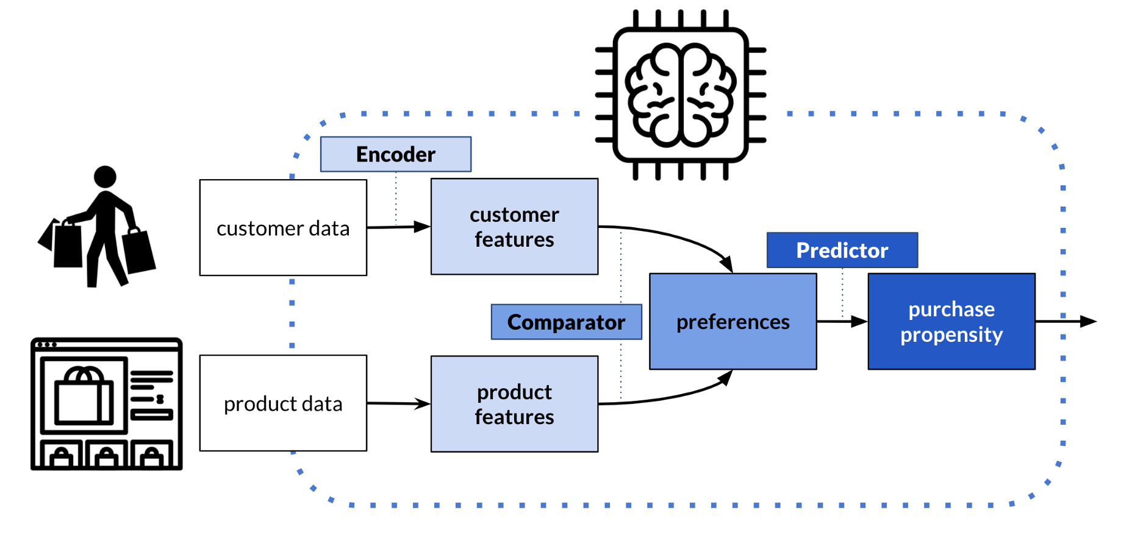
  The calculation of CLV involves analysing various factors such as purchase frequency, average order value, retention rate, and customer acquisition cost. Traditionally, businesses relied on historical data to estimate CLV, but with advancements in predictive analytics, machine learning, and artificial intelligence (AI), companies can now forecast CLV with greater accuracy. These advanced techniques enable businesses to anticipate customer behaviours, personalize marketing efforts, and enhance customer experiences, ultimately leading to higher retention rates and increased revenue.

Slide 6
OBJECTIVE
  This study aims to develop a strategic forecasting model for Customer Lifetime Value (CLV) using predictive analytics. By applying the BG/NBD and Gamma-Gamma probabilistic models, the research seeks to estimate customer transaction frequency, retention probabilities, and monetary value per transaction. The objective is to enhance customer relationship management (CRM) by enabling businesses to segment customers based on CLV, prioritize high-value clients, and refine retention strategies. Through data preprocessing and exploratory data analysis (EDA), the study provides actionable insights to optimize revenue and reduce customer acquisition costs.

Slide 7
SCOPE
  This study explores the application of predictive analytics to forecast Customer Lifetime Value (CLV), aiding businesses in strategic decision-making. It focuses on utilizing the BG/NBD and Gamma-Gamma models to estimate customer retention, transaction frequency, and monetary value. The research covers data preprocessing techniques, including cleansing and feature aggregation, alongside exploratory data analysis to identify transaction patterns. Additionally, it examines customer segmentation based on CLV to optimize retention strategies and resource allocation. The findings provide actionable insights for businesses to enhance customer relationship management, reduce churn, and maximize revenue through data-driven decision-making.

Slide 8
LITERATURE SURVEY
Title & Authors | Methodology (Data Format) | Proposed System | Cons | Conclusion
TITLE: Strategic Forecasting of Customer Lifetime Value: Enhancing Business Insights Through Predictive Analytics AUTHOR: A. Mammadzada, E. Alasgarov, A. Mammadov | Uses transactional data with key features: recency, frequency, and monetary value. Data preprocessing includes cleansing and aggregation. | Implements BG/NBD and Gamma-Gamma models to predict CLV, segment customers, and optimize retention strategies. | Model assumptions may not always hold; requires high-quality data; limited adaptability to rapidly changing customer behavior. | Predictive analytics enhances CLV estimation, helping businesses prioritize high-value customers, improve retention, and maximize revenue.

Slide 9
Title & Authors | Methodology (Data Format) | Proposed System | Cons | Conclusion
TITLE: Predicting Customer Lifetime Value through Data Mining Technique in a Direct Selling Company AUTHOR: A. P. Mauricio, J. M. M. Payawal, M. A. Dela Cueva, V. C. Quevedo | Utilizes transactional and customer data; applies data mining techniques for pattern recognition and CLV prediction. | Implements data mining models to analyze purchasing behavior and predict CLV for customer segmentation and retention strategies. | Accuracy depends on data quality; may not generalize well across different industries; requires computational resources. | Data mining techniques improve CLV prediction, aiding direct selling companies in customer prioritization and revenue optimization.

Slide 10
Title & Authors | Methodology (Data Format) | Proposed System | Cons | Conclusion
TITLE: Customer Lifetime Value Prediction Using Embeddings AUTHOR: Benjamin Chamberlain, Ângelo Cardoso, C.H. Liu, Roberto Pagliari, Marc Deisenroth | Uses customer transactional data; applies embeddings for feature representation and predictive modeling. | Leverages machine learning and embeddings to predict CLV, capturing complex customer behavior patterns. | Requires large datasets; computationally intensive; model interpretability may be challenging. | Embedding-based models improve CLV prediction accuracy, enabling better customer insights and retention strategies.

Slide 11
Title & Authors | Methodology (Data Format) | Proposed System | Cons | Conclusion
TITLE: The Research of Customer Lifetime Value Related to Risk Factors in the Internet Business: Exampled by Online Car-hailing Industry AUTHOR: H. Jia, C. Li | Uses online car-hailing transaction data; considers risk factors affecting CLV. | Analyzes CLV in relation to customer behavior and risk factors, improving business decision-making. | Industry-specific; risk factors may vary across platforms; requires continuous data updates. | Identifying risk factors enhances CLV prediction, helping online car-hailing businesses optimize customer management.

Slide 12
Title & Authors | Methodology (Data Format) | Proposed System | Cons | Conclusion
TITLE: Customer Lifetime Value Prediction in Business: An Analytical Approach AUTHOR: Pavel Jasek, Lenka Vrana, Lucie Sperkova, Zdenek Smutny, Marek Kobulsky | Uses business transaction data; applies analytical modeling and statistical techniques for CLV estimation. | Develops a structured approach to predict CLV, integrating various customer metrics for better decision-making. | Model accuracy depends on data quality; industry-specific factors may affect generalization. | Analytical models improve CLV forecasting, helping businesses enhance customer segmentation and revenue strategies.

Slide 13
EXISTING SYSTEM
  The traditional approach to Customer Lifetime Value (CLV) prediction primarily depends on statistical techniques, rule-based frameworks, and fundamental regression models to estimate a customer’s long-term worth to a business. One widely adopted method is Recency, Frequency, and Monetary (RFM) analysis, which segments customers based on their past purchasing behaviours and assigns scores to determine their likelihood of continued engagement.
  While RFM analysis is straightforward and easy to interpret, it lacks predictive accuracy and does not incorporate the uncertainties associated with customer activity over time. Additionally, many businesses employ cohort analysis, a technique that categorizes customers based on their acquisition period and observes their spending patterns. Although cohort analysis provides useful insights into customer retention trends, it assumes a level of consistency in customer behaviour across different timeframes, which may not align with the rapidly evolving nature of consumer preferences and market dynamics.

Slide 14
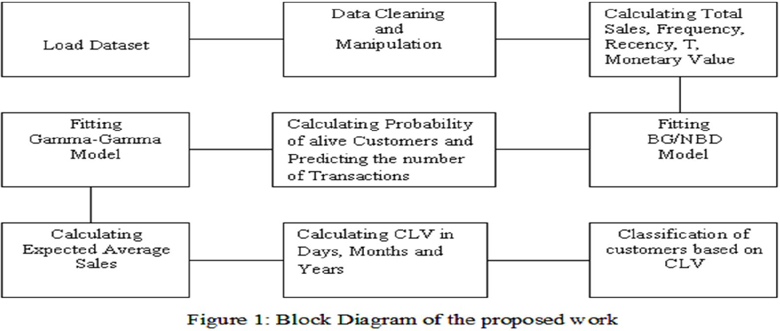
The block diagram in visually represents the workflow of the proposed approach for predicting Customer Lifetime Value (CLV) using probabilistic models. It consists of multiple sequential steps that guide the process, from loading the dataset to the final classification of customers based on their estimated CLV. The first step in the process is loading the dataset, which contains transaction records of customers, including details such as purchase dates, amounts spent, and customer IDs. This dataset, sourced from the UCI Machine Learning Repository, serves as the foundation for further analysis. Once the dataset is loaded, the next step is data cleaning and manipulation to prepare it for modelling. This involves handling missing or null values, removing duplicate records, correcting inconsistencies, and formatting the data in a structured way.

Slide 15
PROPOSED SYSTEM
  The system follows a well-structured workflow that begins with data collection and preprocessing, where raw customer transaction records are gathered, cleaned, and aggregated to extract meaningful features essential for CLV estimation. This preprocessing step involves handling missing values, removing inconsistencies, and ensuring data quality before transforming transactional data into recency, frequency, and monetary value (RFM) metrics, which serve as the foundation for predictive modelling. Once the data is processed, Exploratory Data Analysis (EDA) is performed to uncover hidden patterns in customer purchasing behaviour, such as identifying customers with frequent purchases, high spending tendencies, or varying retention rates over time. This step provides valuable insights into customer engagement trends, transaction frequency distributions, and spending behaviours, enabling businesses to better understand their customer base and refine their strategic approaches to retention and marketing.

Slide 16
  Once CLV is estimated, the system segments customers into different value groups, such as high-value, moderate-value, and low-value customers, allowing businesses to tailor their marketing and retention strategies accordingly. High-value customers, for instance, may receive exclusive offers, personalized discounts, or loyalty rewards, while lower-value customers may be targeted with re-engagement campaigns to encourage repeat purchases. This segmentation enables businesses to prioritize customer engagement efforts, allocate marketing budgets more effectively, and enhance overall customer satisfaction while optimizing revenue generation.
  To make these insights easily accessible, the system is deployed as an interactive web application using Streamlit, providing businesses with a user-friendly interface where they can input customer data, visualize CLV predictions, and generate actionable reports in real time. This web-based approach ensures that CLV analysis is not only data-driven but also intuitive and interactive, allowing non-technical users to benefit from predictive analytics without requiring deep expertise in data science.
  Through a combination of traditional statistical methods and modern machine learning techniques, this system provides a holistic approach to CLV prediction, ensuring that businesses can not only understand customer value but also take proactive steps to enhance customer loyalty and maximize lifetime revenue potential.

Slide 17
SOFTWARE REQUIREMENTS
Programming Language: Python (3.8 or higher)
Development Environment: Jupyter Notebook, VS Code, PyCharm
Dataset: Online Retail Dataset (CSV Format)
Model Training & Storage: Pre-trained models (BG/NBD, Gamma-Gamma, XGBoost, LightGBM)
Hardware Requirements: Intel i5/AMD equivalent, 8GB RAM (16GB recommended), 10GB free storage, GPU (optional)
Deployment & Hosting: Streamlit (local), Streamlit Cloud, AWS, Heroku, Google Cloud

Slide 18
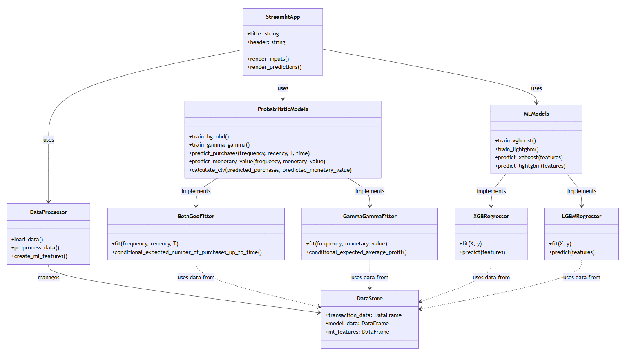
CLASS
DIAGRAM
The provided UML diagram outlines the architecture of a Customer Lifetime Value (CLV) prediction system, incorporating probabilistic modelling and machine learning techniques within a Streamlit-based web application. The system consists of several key components, each responsible for different stages of data processing, modelling, and prediction. At the highest level, the StreamlitApp class serves as the front-end interface, allowing users to input data and view predictions.

Slide 19
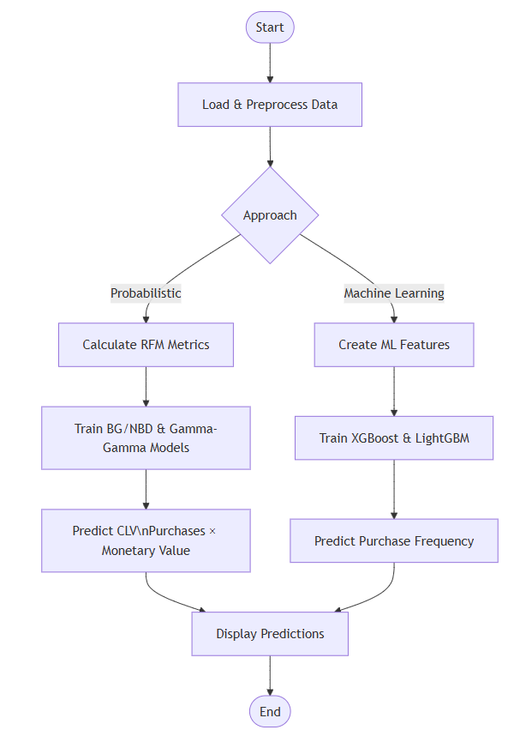
FLOW
CHART
The given flowchart represents a hybrid approach for predicting Customer Lifetime Value (CLV) by leveraging both probabilistic modelling and machine learning techniques. The process begins with loading and preprocessing the data, where raw customer transaction data is cleaned, structured, and prepared for further analysis. From this step, the workflow diverges into two parallel approaches Probabilistic Modelling and Machine Learning.

Slide 20
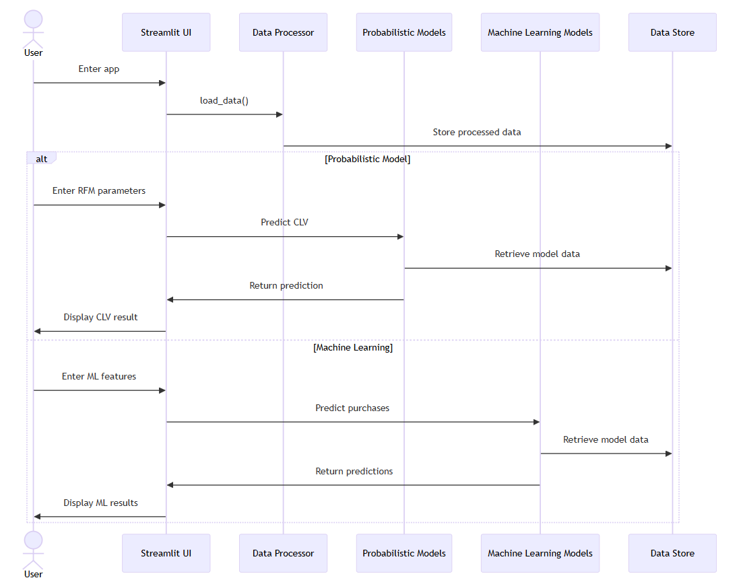
SEQUENCE
DIAGRAM
The sequence diagram illustrates the workflow of predicting Customer Lifetime Value (CLV) using a web-based interface built with Streamlit. The process begins when the user enters the application, triggering the Streamlit UI to request data loading from the Data Processor. The Data Processor then fetches and processes the necessary transactional data, storing it in the Data Store for further analysis. At this point, the workflow splits into two alternative paths

Slide 21
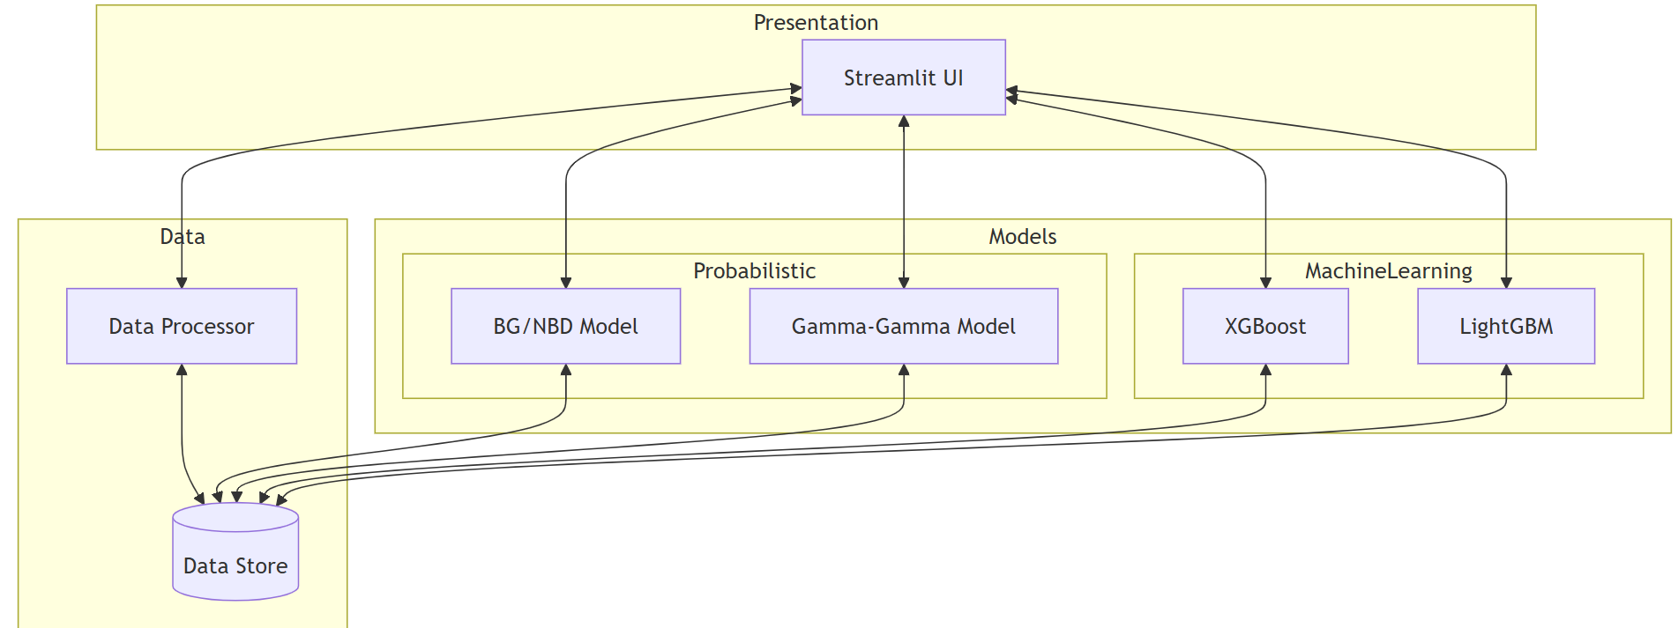
ARCHITECTURE
DIAGRAM
The system architecture consists of multiple interconnected components designed to facilitate Customer Lifetime Value (CLV) prediction and analysis. At the core of the system is the Data Processing module, which retrieves raw customer transaction data from the Data Store, cleanses it, and extracts key features such as recency, frequency, and monetary value. The processed data is then fed into two distinct modelling approaches Probabilistic Models and Machine Learning Models.

Slide 22
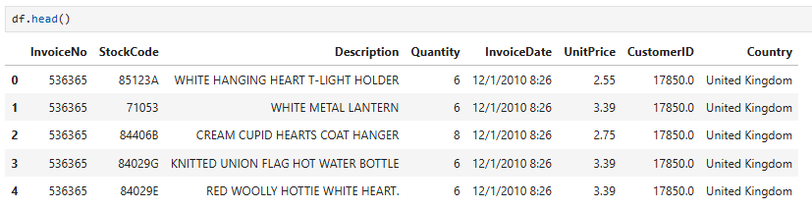
RESULTS
  The dataset includes several key attributes: Invoice No indicates the transaction ID, and Stock Code represents the unique identifier for each product. The Description column provides the name of the purchased item, while Quantity shows the number of units bought in that transaction. The Invoice Date records the exact date and time of the purchase, and Unit Price specifies the price per unit of the product.

Slide 23
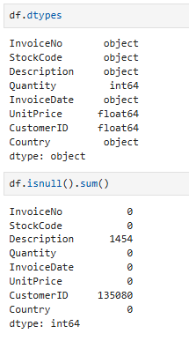
  The dataset consists of multiple data types, including object, integer, and float. The Invoice No, Stock Code, Description, Invoice Date, and Country columns are stored as objects, indicating that they contain categorical or textual data. The Quantity column is of type int64, representing whole numbers, while Unit Price and CustomerID are stored as float64, suggesting they contain decimal values.

Slide 24
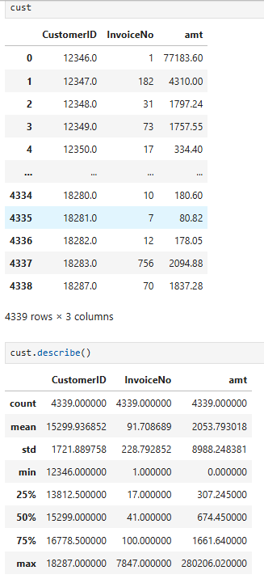
  The dataset "cust" consists of three columns: CustomerID, Invoice No, and amt (amount spent by the customer). It contains 4,339 rows, representing unique customer transactions. The CustomerID column identifies individual customers, while Invoice No represents the number of invoices or purchases made by each customer. From the descriptive statistics, the CustomerID values range from 12,346 to 18,287, showing the spread of unique customers.

Slide 25
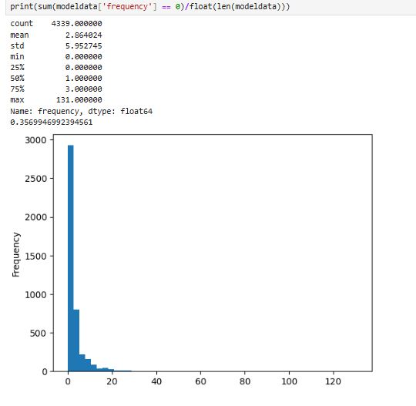
  The dataset contains 4,339 records, where the 'frequency' column represents the number of repeat purchases made by customers. The summary statistics reveal that the mean frequency is approximately 2.86, with a standard deviation of 5.95, indicating that most customers have low purchase frequency, but some have significantly higher values. The minimum frequency is 0, meaning some customers have only made a single purchase, while the maximum is 131, suggesting a small subset of highly frequent buyers.

Slide 26
CONCLUSION
  In conclusion, this study demonstrates the effectiveness of predictive analytics in forecasting Customer Lifetime Value (CLV) to enhance business decision-making. By applying the BG/NBD and Gamma-Gamma models, we estimate customer transaction frequency, retention probability, and monetary value, providing valuable insights into long-term customer relationships. Through data preprocessing and exploratory data analysis (EDA), key behavioural patterns emerge, allowing businesses to segment customers based on their potential value. The findings emphasize the critical role of customer retention strategies, highlighting that maintaining loyal customers is more cost-effective than acquiring new ones. Ultimately, this approach equips businesses with data-driven strategies to prioritize high-value customers, optimize marketing efforts, and maximize revenue growth, reinforcing the significance of CLV in customer relationship management.

Slide 27
FUTURE SCOPE
  The future scope of Customer Lifetime Value (CLV) forecasting lies in enhancing predictive accuracy, integrating advanced machine learning techniques, and expanding real-time applications. Incorporating deep learning models and reinforcement learning can further refine CLV predictions by capturing non-linear relationships and dynamic customer behaviours. Additionally, integrating external data sources such as social media interactions, market trends, and economic indicators can enrich customer insights, making CLV models more robust. The application of real-time analytics and automation in CRM systems will enable businesses to adapt personalized marketing strategies dynamically, improving customer engagement and retention. Furthermore, leveraging AI-driven recommendation engines can optimize cross-selling and upselling opportunities, enhancing revenue potential. Lastly, as data privacy regulations evolve, developing ethical and compliant CLV models will be crucial for sustaining customer trust and long-term business growth.

Slide 28
REFERENCES
A. Mammadzada, E. Alasgarov and A. Mammadov, "Application of BG / NBD and Gamma-Gamma Models to Predict Customer Lifetime Value for Financial Institution," 2021 IEEE 15th International Conference on Application of Information and Communication Technologies (AICT), 2021, pp. 1-6, doi: 10.1109/AICT52784.2021.9620535.
A. P. Mauricio, J. M. M. Payawal, M. A. Dela Cueva and V. C. Quevedo, "Predicting Customer Lifetime Value through Data Mining Technique in a Direct Selling Company," 2016 International Conference on Industrial Engineering, Management Science and Application (ICIMSA), 2016, pp. 1-5, doi: 10.1109/ICIMSA.2016.7504027.
Chamberlain, Benjamin & Cardoso, Ã‚ngelo & Liu, C.H. & Pagliari, Roberto & Deisenroth, Marc. (2017).
Customer Lifetime Value Prediction Using Embeddings. 1753-1762. 10.1145/3097983.3098123.
Jasek, Pavel; Vrana, Lenka; Sperkova, Lucie; Smutny, Zdenek; Kobulskx, Marek. Journal of Business Economics and Management; Vilnius Vol. 20, Iss. 3, (Apr 2019): 398-423. DOI:10.3846/jbem.2019.9597

Slide 29
L. C. Yean and K. T. V. Khoo, "Customer relationship management: Computer-assisted tools for customer lifetime value prediction," 2010 International Symposium on Information Technology, 2010, pp. 1180-1185, doi: 10.1109/ITSIM.2010.5561487.
L. C. Yean and V. K. T. Khoo, "Customer Relationship Management: Lifecycle of Predicting Customer Lifetime Value," 2010 Second International Conference on Computer Research and Development, 2010, pp. 88-92, doi: 10.1109/ICCRD.2010.24.
T. T. Win and K. S. Bo, "Predicting Customer Class using Customer Lifetime Value with Random Forest Algorithm," 2020 International Conference on Advanced Information Technologies (ICAIT), 2020, pp. 236- 241, doi: 10.1109/ICAIT51105.2020.9261792.
X. N. Wang, "Research of CLV Forecasting Model Based on E-Commerce Website," 2009 First International Conference on Information Science and Engineering, 2009, pp. 3002-3005, doi: 10.1109/ICISE.2009.906.
Jake Vander plas, “Python Data Science Handbook: Essential tools for working with data”, O‘Reilly Publishers,I Edition.

